Slide 2


Notes:
Hi everyone, my name is Tomasz, I am a member of a .NET Community and [->]

Slide 3


Azure Functions
Notes:
[->] and today we are going to talk about Azure Functions. What are those? What is Microsoft Azure? [Next slide]

Slide 4

What is Azure?
Microsoft Azure is an ever-expanding set of cloud services to help your organization meet your business challenges.
It’s the freedom to build, manage, and deploy applications on a massive, global network using your favorite tools and frameworks.
Microsoft Azure Overview
Notes:
As we can read “Microsoft Azure is a set of cloud services”. Google Drive, Gmail, Office 365 (now Microsoft three-sixty-five) – those web applications are perfect examples of “cloud services”.
They are ready to use,
we are not troubled by configuring them,
maintaining them,
they are offered to us as a cloud services. We just use them. Everything else is handled for us.
Microsoft Azure is nothing more than a bunch of such services, although not so simple to use. Azure Functions is one of them.

Slide 5
What are Azure Functions?
More than just event-driven serverless compute.
Microsoft Azure Overview
Azure Function is a serverless, stateless piece of code which is run by the trigger, able to connect to other Azure services to read and/or write data, running 100% in the cloud.
@Me
Notes:
Azure Function is a “serverless, stateless piece of code which is run by the trigger”.
“Serverless” means that we do not need a server on our side to use Azure Functions, all what is needed is given by Azure.

Slide 6








What are Azure Functions?
Serverless?
More than just event-driven serverless compute.
Microsoft Azure Overview
Azure Function is a serverless, stateless piece of code which is run by the trigger, able to connect to other Azure services to read and/or write data, running 100% in the cloud.
@Me
Notes:
Cloud provider is handling those details for us. In this case cloud provide stands for Microsoft.

Slide 7










What are Azure Functions?
Serverless?
More than just event-driven serverless compute.
Stateless?
Microsoft Azure Overview
Azure Function is a serverless, stateless piece of code which is run by the trigger, able to connect to other Azure services to read and/or write data, running 100% in the cloud.
@Me
Notes:
“Stateless” means that our Azure Functions won’t relay on any previous events or states. We just run our code and provide every piece of data it will need for that execution.

Slide 8
What are Azure Functions?
More than just event-driven serverless compute.
Microsoft Azure Overview
Azure Function is a serverless, stateless piece of code which is run by the trigger, able to connect to other Azure services to read and/or write data, running 100% in the cloud.
@Me
Notes:
As for the last part: “run by trigger” [->]

Slide 9








Run by a trigger?
Timer Trigger
Azure Blob Storage
Azure Service Bus
Topic
Azure Cosmos DB
Azure Service Bus
Queue
Azure Queue Storage
Azure Event Grid
Azure IoT Hubs
Azure Event Hubs
HTTP Trigger
Notes:
[->] here is the full list of triggers provided to us by the Microsoft Azure.
Most of them are separated services and deserves their own presentation [->]

Slide 10
Run by a trigger?
Timer Trigger
Azure Blob Storage
Azure Service Bus
Topic
Azure Cosmos DB
Azure Service Bus
Queue
Azure Queue Storage
Azure Event Grid
Azure IoT Hubs
Azure Event Hubs
HTTP Trigger
Notes:
[->] so let us just focus on these two for now. The simplest one – HTTP Trigger which allows us to run our function once we send a request over HTTP, much like an API call [->]

Slide 11
Run by a trigger?
Timer Trigger
Azure Blob Storage
Azure Service Bus
Topic
Azure Cosmos DB
Azure Service Bus
Queue
Azure Queue Storage
Azure Event Grid
Azure IoT Hubs
Azure Event Hubs
HTTP Trigger
Notes:
[->] and the second one – Azure Cosmos DB, which can serve as a persistent layer for our cloud solution.

Slide 12

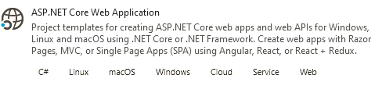


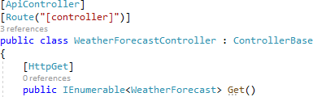

HTTP API
API Template
HTTP Trigger
Entity Framework Core
Azure Cosmos DB
Notes:
In fact let us create and run some simple solutions, one for ASP.NET Core Web Application and one for Azure Functions and make them do the same.
Let us open Visual Studio:
Select .\Capgemini.NET\AzureFunctions\Demo\Begin\HTTP Trigger directory
Open already created blank solution named “Projects”
First let us scaffold an ASP.NET API project:
create some new project
With the ASP.NET Core Web Application template
Select Add to solution
Select API template
Disable Configure for HTTPS
Run
Now for Azure Function:
create some new project
With the Azure Functions template
Select Add to solution
Select HTTP Trigger template
Run
Open Function1.cs and WeatherForecastController.cs side by side.
We want to make Azure Function behave same as API:
Default route:
[HttpTrigger(…, Route = null)] -> [FunctionName("Function1")]
[Route("[controller]")] -> [Route(“api/[controller]")]
HTTP Method:
[HttpTrigger(…"get", "post“…)]
[HttpGet]
Authorization:
[HttpTrigger(AuthorizationLevel.Function,…)]
[AllowAnonymous]
Signature:
public static async Task<IActionResult> Run() // note static here as well in the class
public IEnumerable<WeatherForecast> Get()

Slide 13
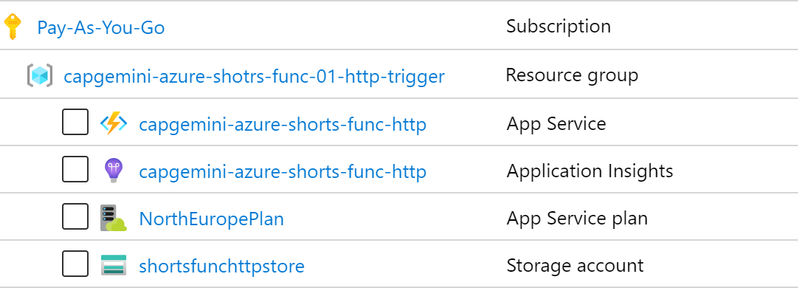

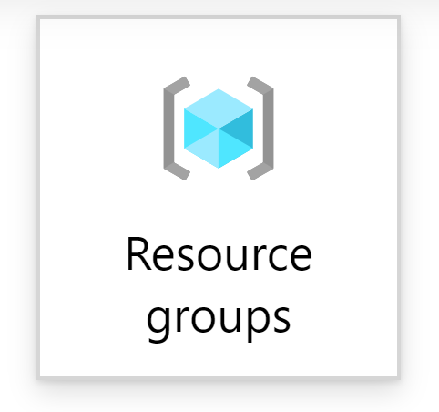
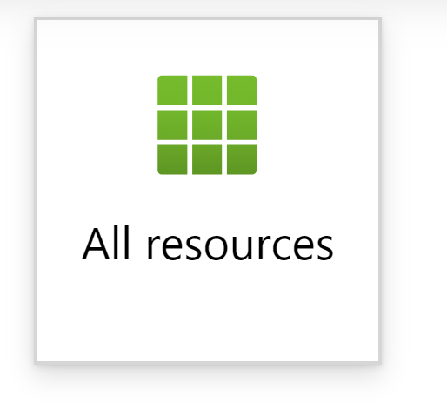
HTTP API
Demo
Notes:
So now as we have our working solution, let us move it to the cloud. Right here we see the tools we need to use.
First, we will log into my Azure account and by using my paid subscription, we will create a resource group.
The resource group is nothing more than a container for our future resources, such as our Azure Function in this example.
All the resource You se here will be created by the Azure Portal wizard so let us do not worry about them for now.
Got to Azure Portal
“Create a resource”
Select “Function App”
Create a resource group e.g. “azure-shorts-demo-app”
Give a name for a function app e.g. “azure-shorts-demo-app”
Select runtime
Select region
Go next to “Hosting” (storage account)
Go next to “Monitoring” (app insights)
Create

Slide 14
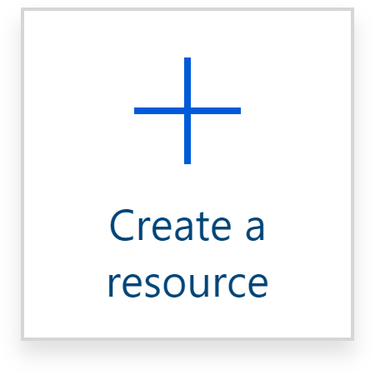

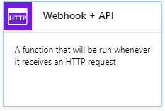
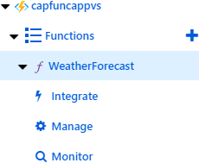

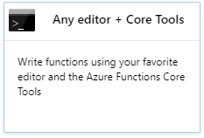
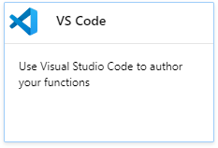
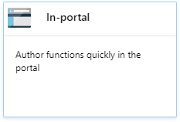
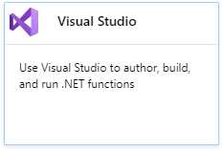
HTTP API
Demo
Create storage account
( , , , )
Create Function App
Notes:
As we will se in a minute, Azure will create for us all compomers needed for our function to run,
will offer a couple options to create new Azure Functions either via Visual Studio, as we did already, by other Code Editors or directly in the portal.
For now let us just recreate our example from previous slides in the portal to create a Weather Forecast function:
Go to the created resource,
We can go to the given URL and see how our ap in currently working
Hit “New function”
Select “In Portal”
Select “Webhook + API”
Hit “Create”
And we are done.
We can:
Get the URL of our function and run it
Test it locally in the portal
And we can build our project from here.
8. But what we really want to do is to deploy our existing solution, so we go to:
“azure-shorts-demo-app”,
Select “Get publish profile”
Go to Visual Studio and select “Publish” on our project,
Select the downloaded profile and publish.

Slide 15



HTTP API
API Template
HTTP Trigger
Entity Framework Core
Azure Cosmos DB

Slide 16
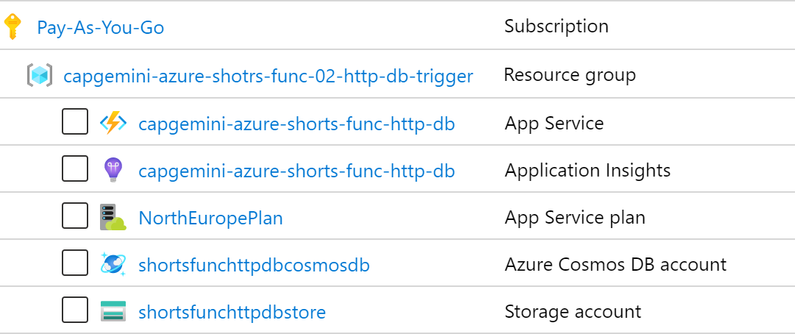
HTTP API
Demo

Slide 17


Bindings
Inputs
Outputs
Azure Queue Storage
Azure Blob Storage
HTTP
Azure Service Bus
Azure Table Storage
Azure Blob Storage
Azure Table Storage
Orchestration Client
Durable Client
Azure Cosmos DB
SignalR Connection Info
Azure Event Hubs
SendGrid
Twilio SMS
Azure Cosmos DB
SignalR

Slide 18


Bindings
Trigger
Input
Function
Output
Trigger
Input
Function
…

Slide 20
Icons made by Zlatko Najdenovski from Flaticon

